Slide 1
Introdution to geographic information systems
Junaid Aziz Khan
Institute of geographical information systems

Slide 2
Presentation Outline
Definitions of GIS
The Feature Model
Subsystems of GIS
Key Activities in a GIS
Components of GIS
Applications of GIS

Slide 3
Lesson Objectives
Understand what a GIS is
Understand how a GIS functions
Understand how spatial data is represented in a GIS
Look at some GIS applications

Slide 4
“gis” stands for?
G stands for geographic, so we know that GIS has something to do with geography.
I stands for information, so we know that GIS has something to do with information, namely geographic information.
S stands for system, so we know that GIS is an integrated system of geography and information tied together.

Slide 5
Geographic
Geography -Pattern and process of human and physical phenomena on the surface of earth.
What is where? (Spatial Distribution and Variations)
Why is there?(Spatial Interactions)
How do we care?(Spatial Planning and Management)

Slide 6
Information
Information is processed data useful for problem solving.
Data is basically the collection of facts and figures that pertain to places, people, things, events, and concepts.

Slide 7
System
A group of interacting, interrelated, or interdependent elements forming a complex whole (physical or conceptual in nature)
  The human body regarded as a functional physiological unit.
  Solar system
  Water distribution system
  Democratic political system

Slide 8



What is an Information System?
Information System
Data Storage
Query
Information
Information systems can be very simple, such as a telephone directory.
Notes:
This slide gives a simple illustration of how we extract information. A very basic example of an information system is a telephone book. It stores data, but if we pose a question such as “What is John Doe’s phone number?” we can find the answer. However, this information system is limited because if we pose a different question such as “Whose phone number is 555-5555?”, we can not easily obtain the answer.

Slide 9
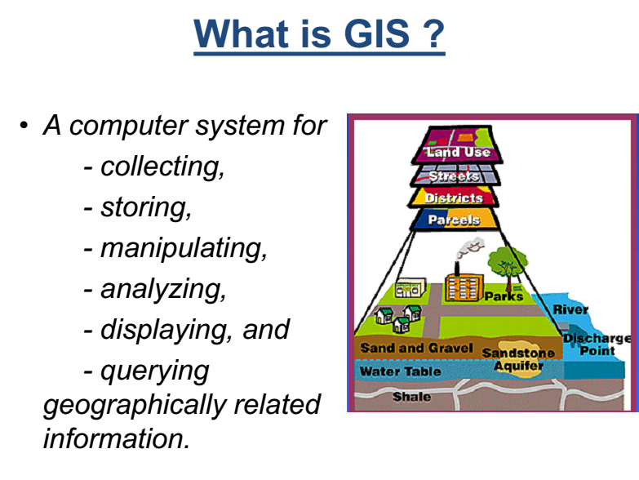
What is a “gis”?
A computer system for
    - collecting,
    - storing,
    - manipulating,
    - analyzing,
    - displaying, and
    - querying
geographically related information.

Slide 10
Defining a “gis”?
“GIS” is a Toolbox
    A powerful set of tools for storing and retrieving, transforming and displaying spatial data from the real world for a particular set of purposes.

Slide 11
Contd…
“GIS” is an Information System
    A special case of information system where the database consists of observations on spatially distributed features, activities or events, which are definable in space as points, lines or areas (i.e. feature model)

Slide 12
    The Feature Model
    Divides a mapped landscape into features, that can be points, lines, or areas/polygons
    Using a GIS involves capturing the spatial distribution of features by measurements of the world or of maps
    Almost all human activity and natural phenomena are spatially distributed, and so can be studied in GIS
    A GIS uses map features to manage data

Slide 13
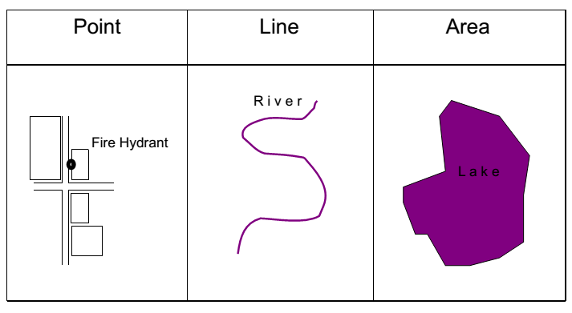
    Features
Notes:
We need symbolize spatial features in order to be able to associate attribute information.
We can classify different features into different dimensions. Each classification of dimension is a conceptual classification.
Points - “0” dimensionality. No length or Width.
Each point is Discrete in that it can only occupy a given point in space at any given time.
Lines - “1” dimensional. Length, but No Width.
Must have a beginning and an ending point.
Polygons - “2” dimensional. Length and Width.
By adding Width, we can describe a feature as having an area.
Surfaces - “3” dimensional. Length, Width, and Height.
Surfaces have infinite number of values (e.g. Elevation). We say that this type of data is Continuous.
When thinking of spatial elements, we must consider Spatial Scale. Depending on scale, we may want to represent a river as a line or a polygon.

Slide 14
Define
problem
Define
problem
Decision
Decision
GIS
Process
GIS
Process
Define GIS
criteria
Output
Define GIS
criteria
Output
Import or
build datasets
GIS
analysis
Import or
build datasets
GIS
analysis
Notes:
GIS PROCESS:
The GIS process involves six steps that are common to what we refer to as the end to end map-making process.
1. Define the spatial problem/question.
.Define the GIS criteria.
.Import or create the data sets
.Perform the GIS analysis
.Create the output
.Decide whether or not the output solves or answers the spatial problem/question. If not, then refine the problem and start the process again.

Slide 15
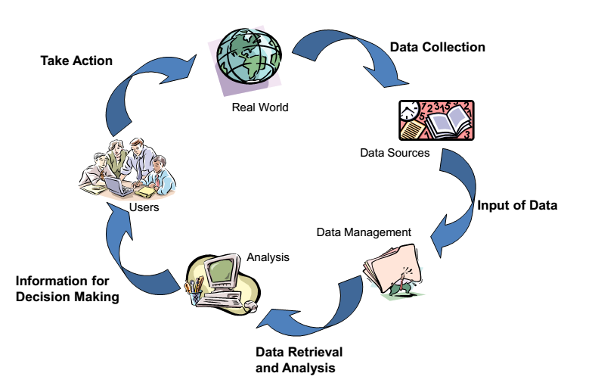
Gis in the planning process

Slide 16
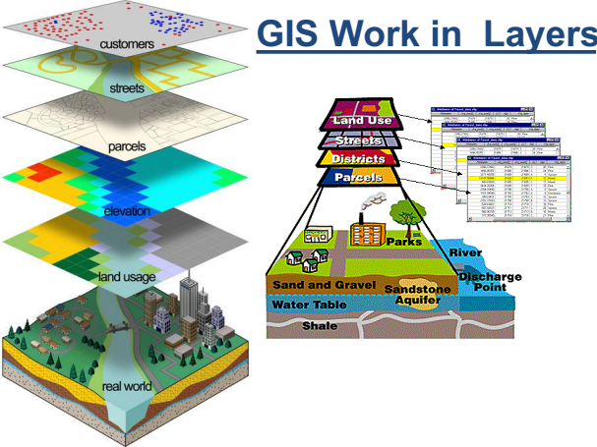
Gis work in layers

Slide 17
Capabilities of GIS / Subsystems
• Data Input Subsystem
– Converts existing data into GIS format
– Common sources of data include paper maps, tables of attributes, aerial photos, and satellite imageries
– A major bottleneck in the implementation of GIS
• Data Storage and Retrieval Subsystem
– Organizes the data, spatial and attribute, in a form which permits it to be quickly retrieved by the user for analysis.
– Permits rapid and accurate updates to be made to the database
– Involves use of a database management system (DBMS) for maintaining attribute data

Slide 18
Capabilities of GIS / Subsystems
• Data Manipulation and Analysis Subsystem
– Allows the user to define and execute spatial and attribute procedures to generate derived information
– This subsystem is commonly thought of as the heart of a GIS, and usually distinguishes it from other database information systems and computer-aided drafting (CAD) systems.
• Data Output and Display Subsystem
– Presentation of outputs by maps and visualization tools (e.g. 3-D, animation)
– Allows the user to generate graphic displays, normally maps, and tabular reports representing derived information products

Slide 19
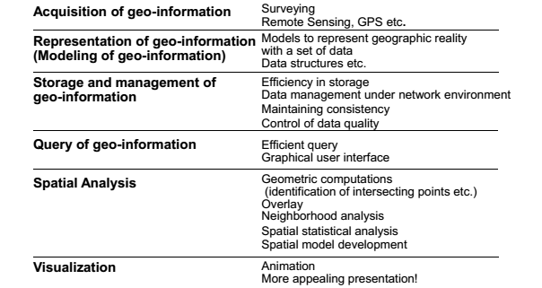
Key activities/tasks in a “gis”

Slide 20
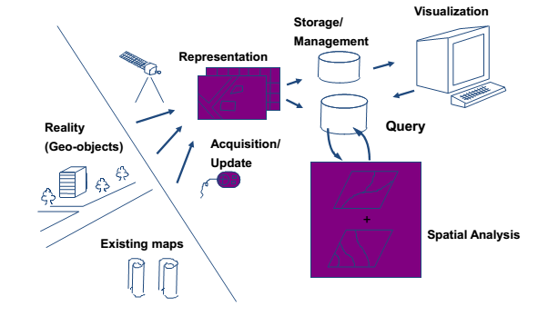
“gis” processing flow

Slide 21
How “gis” works?
GIS
DATA
SOFTWARE
PEOPLE AND PROCEDURES
HARDWARE
Data has spatial and attribute information to explain where something is and what something is
Software is used to open, analyse, display and store geographic data.
Data and software run-off hardware (ranging from centralized computers to desktops and to handheld devices. GI can be created, shared and used from each of these hardware devices.
People use GIS software to perform GIS tasks on geographic data. People create and follow procedures to order GIS tasks and make their work more efficient.
Notes:
These components are integrated into GIS in order to answer the questions, make decisions and provide tools to create, share and use GI.

Slide 22
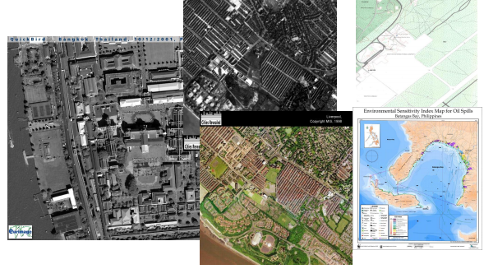
“gis” Data

Slide 23
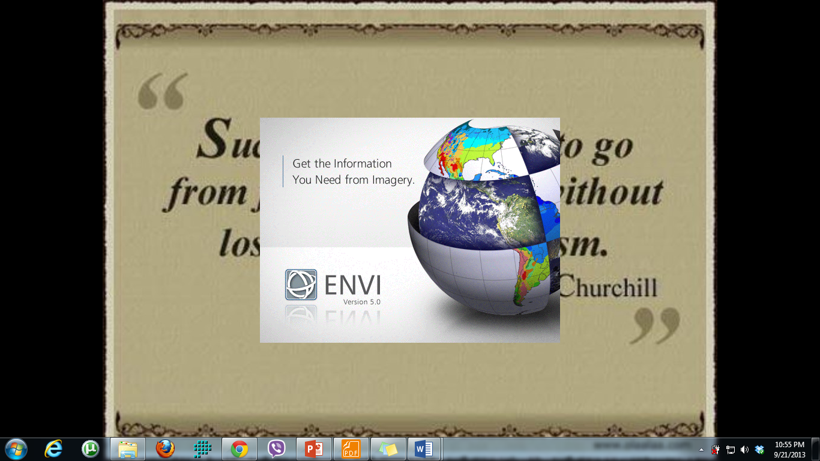
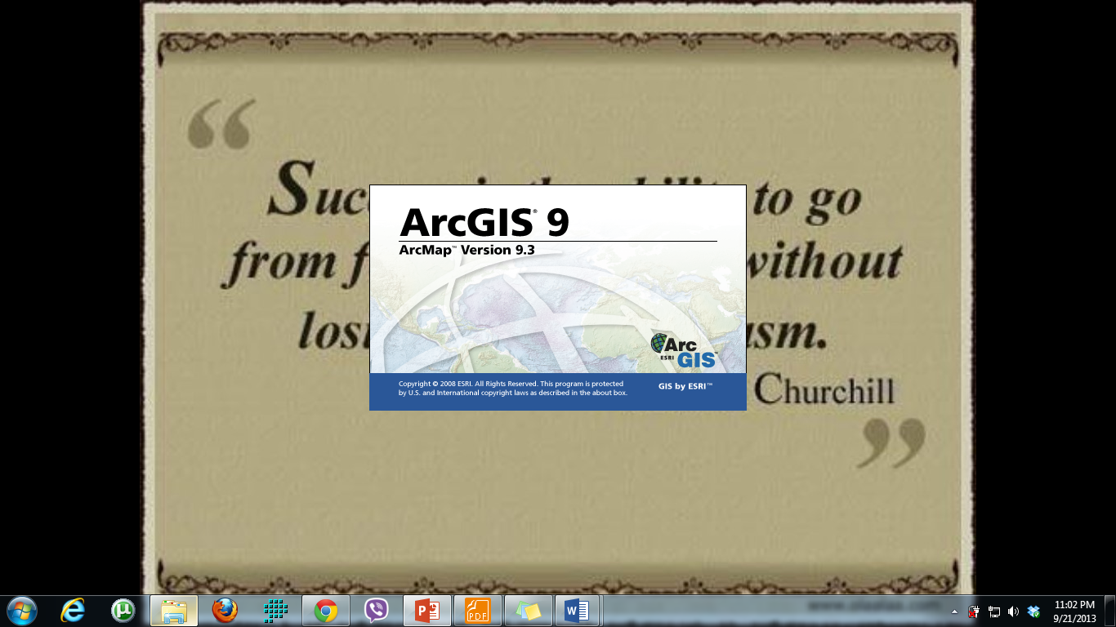
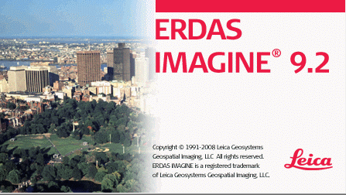
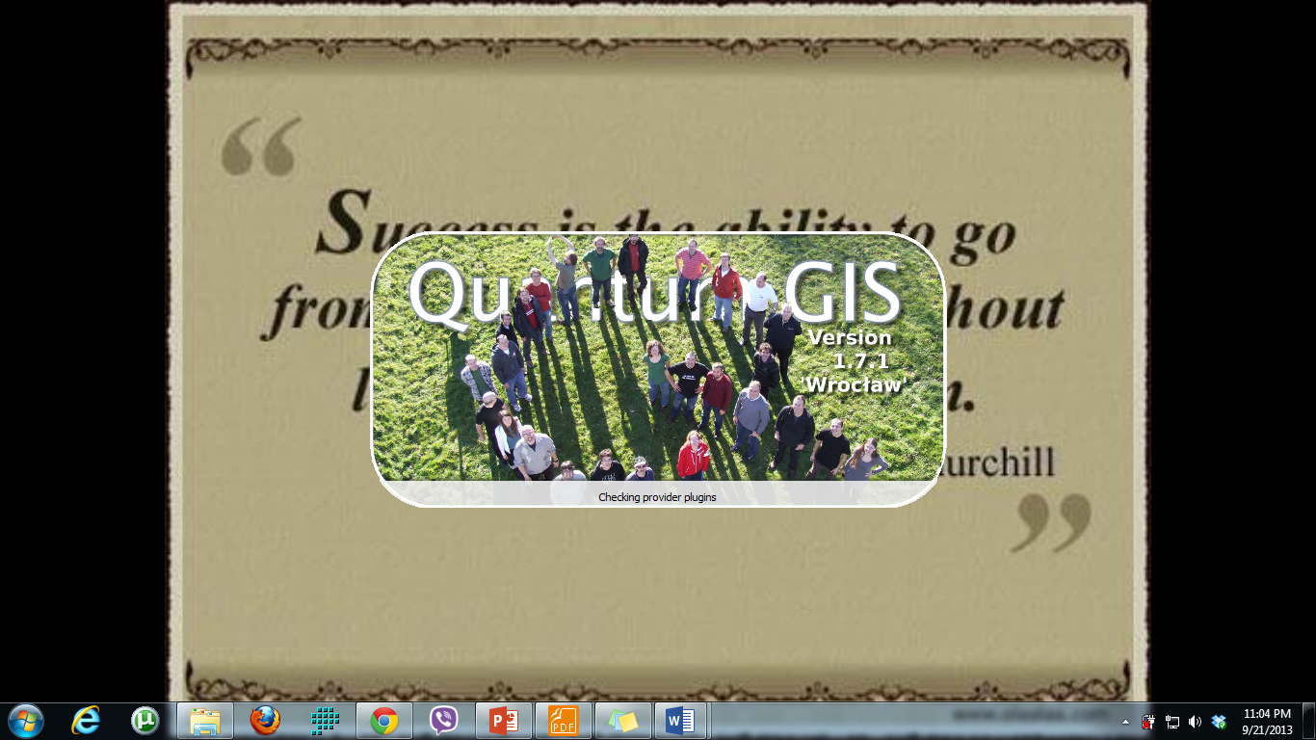
“gis” Softwares

Slide 24
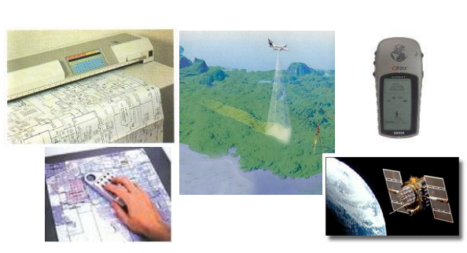
“gis” Hardware

Slide 25
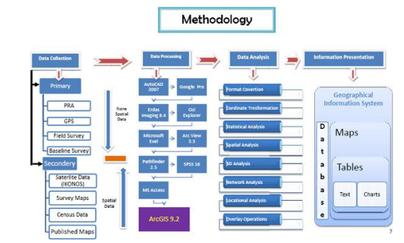
“gis” workflows

Slide 26
SPATIAL ANALYSIS METHODS
Analysis and manipulation of attribute data
– Transform
– Aggregation
– Overlay, etc.
Spatial analysis
– Buffering
– Neighborhood analysis
– Network analysis
– Spatial statistical analysis, etc.
Spatial interpolation
– Point-based data, Areal or volume data
Computation of measures
Geometric (coordinate) transformation

Slide 27
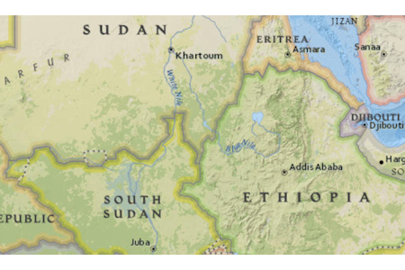
What “gis” can do for us?
Map Location
This map illustrates the location of countries, rivers, and cities within the continent of Africa. Locational maps can be used to determine where things are situated in relation to each other and are often used with navigation.
Notes:
As previously discussed, a GIS uses geographic information to answer questions and make decisions. In order to analyze and assess the information, it needs to be presented in a format that others can understand. One of the most common GIS formats is a GIS map. It can :

Slide 28
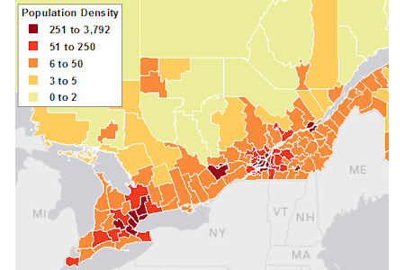
Map Densities
This map illustrates a higher population density in the southeast portion of Canada. Density maps can be used to condense large amounts of data analyzed for correlations and trends. Further analysis could be completed to determine if the denser population is related to the proximity of the border or the proximity of water bodies.
Notes:
As previously discussed, a GIS uses geographic information to answer questions and make decisions. In order to analyze and assess the information, it needs to be presented in a format that others can understand. One of the most common GIS formats is a GIS map.

Slide 29
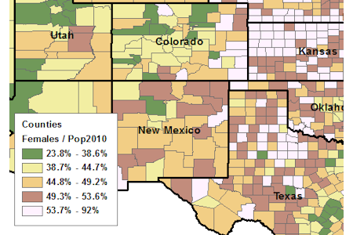
Map Quantities
This map illustrates the percentage of woman located in United States counties. Quantitative maps are often used to find trends; for example, there is a higher percentage of woman living in the eastern states shown on the map.
Notes:
As previously discussed, a GIS uses geographic information to answer questions and make decisions. In order to analyze and assess the information, it needs to be presented in a format that others can understand. One of the most common GIS formats is a GIS map.

Slide 30
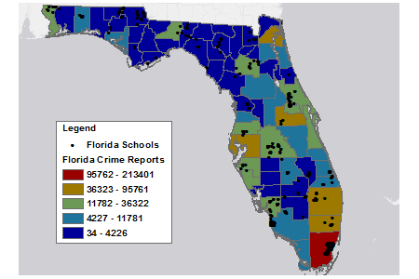
Map what is inside
This map illustrates school locations in relation to crime areas. Mapping what is inside can assist with monitoring and assessment. According to this map, schools located in Miami may be more at risk, since Miami has the highest number of crime reports.
Notes:
As previously discussed, a GIS uses geographic information to answer questions and make decisions. In order to analyze and assess the information, it needs to be presented in a format that others can understand. One of the most common GIS formats is a GIS map.

Slide 31
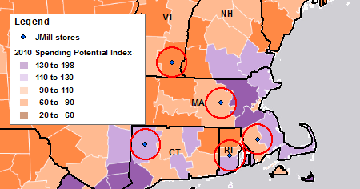
Map what is near-by
This map illustrates the proximity of JMill retail stores to county spending potential. Mapping what is nearby is often used in risk assessment and predictions. JMill predicts higher revenue in the Massachusetts, Connecticut, and Rhode Island stores, since they are located within 20 miles of a higher potential spending index.
Notes:
As previously discussed, a GIS uses geographic information to answer questions and make decisions. In order to analyze and assess the information, it needs to be presented in a format that others can understand. One of the most common GIS formats is a GIS map.

Slide 32
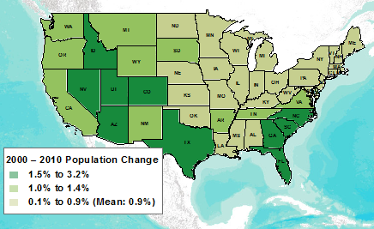
Map Change
This map illustrates population change over the past ten years. The largest population changes occurred in the western and southeastern states. This can be used to assess future trends in urban sprawl and market demands.
Notes:
As previously discussed, a GIS uses geographic information to answer questions and make decisions. In order to analyze and assess the information, it needs to be presented in a format that others can understand. One of the most common GIS formats is a GIS map.

Slide 33
Applications of GIS

Slide 34
Natural Resources ManagemenT
Wildlife habitat
Water resources
Recreation resources
Floodplains
Wetlands
Agricultural lands
Aquifers
Forests
Geology

Slide 35
Facilities Management
Locating underground pipes and cables
Balancing loads in electrical networks
Planning facility maintenance
Tracking energy use
Land Management
Zoning and subdivision planning
Land acquisition
Environmental impact policy
Water quality management
Maintenance of ownership

Slide 36
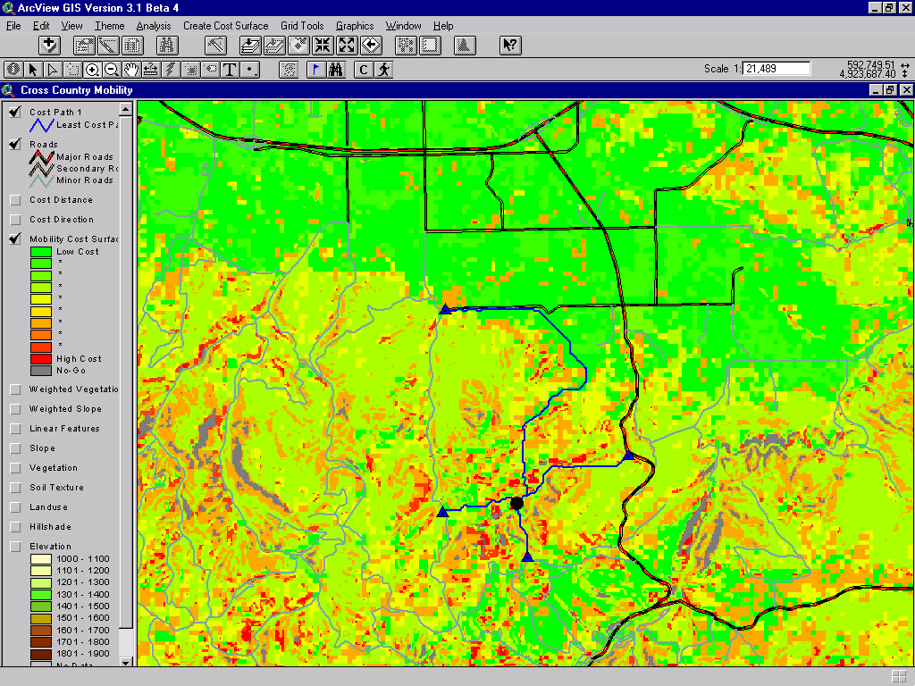
CCM Analysis
Notes:
CCM (Cross Country Movement) Analysis allows the user to model the cost (e.g. time) it would take for a give object to travel from point A to Point B given the difficulty of the terrain.
For example, if a tank had to travel from point A to point B and you new how fast it could travel on certain road types, soil types, and slopes, you could model the travel cost.

Slide 37
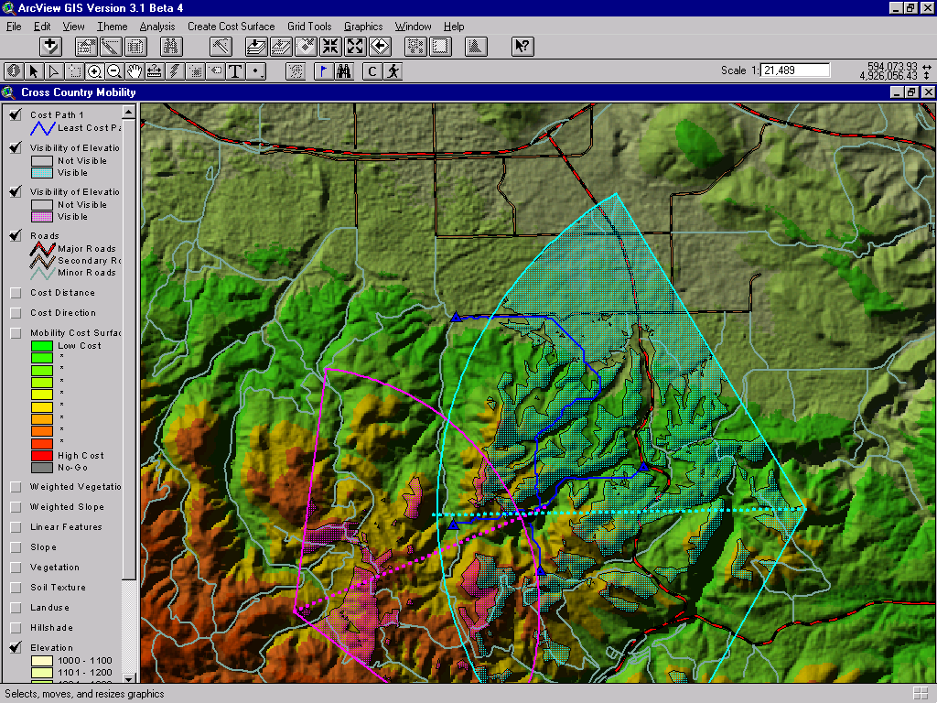
CCM & Viewshed
Notes:
This slide shows a CCM analysis along with a viewshed analysis. The viewshed analysis is used to illustrate what a person can or can not see from a certain point. The two areas denoted by the purple and turquoise angles illustrate two separate viewsheds. The region of overlap shows the area that can be see by both observers from their respective positions.

Slide 38
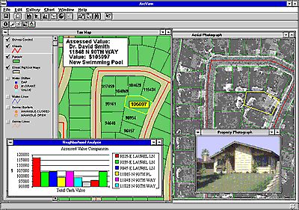
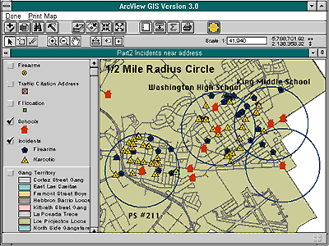
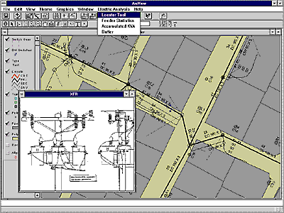
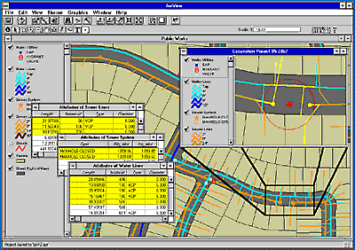
Facilities Management
Notes:
Facilities Management encompasses a wide range of applications. The examples shown above are:
1. Housing Assessments
2. Power Line Maintenance and Tracking
3. Crime around Schools
4. Water lines/pipes Maintenance and Tracking

Slide 39
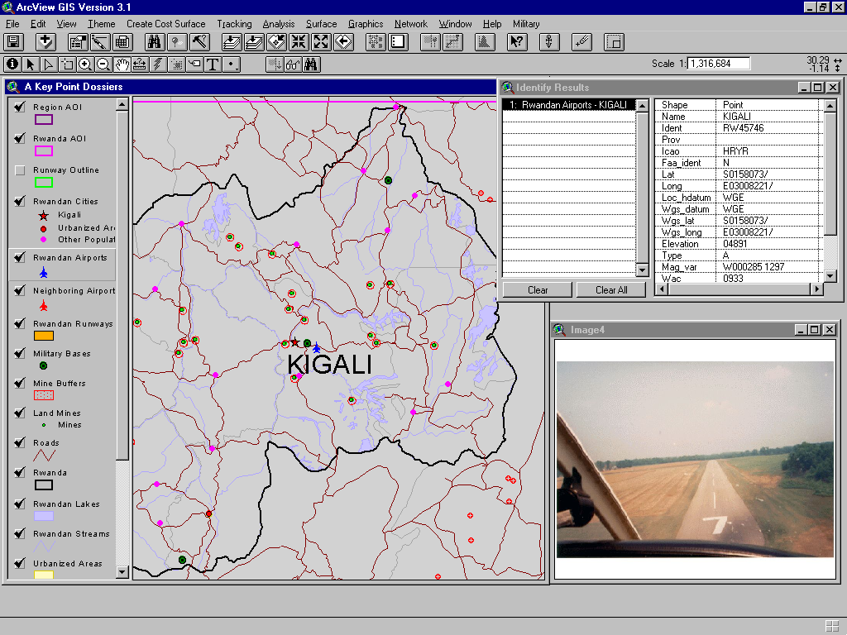
Airfields
Notes:
This slide shows information on Airfields along with a picture/movie that has been hot-linked to the feature.

Slide 40
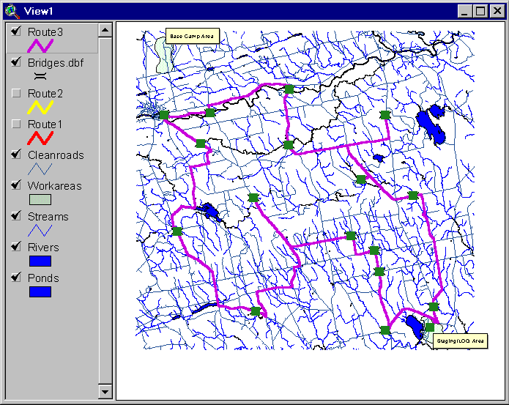
Network Analysis
Notes:
The slide shows a Network model, which gives the best route given certain criteria. The green squares denote bridges, which can serve as a limitations within the model. For example, if a bridge was impassible, we could factor that criteria into our model and the route could be recalculated giving us a different solution.

Slide 41
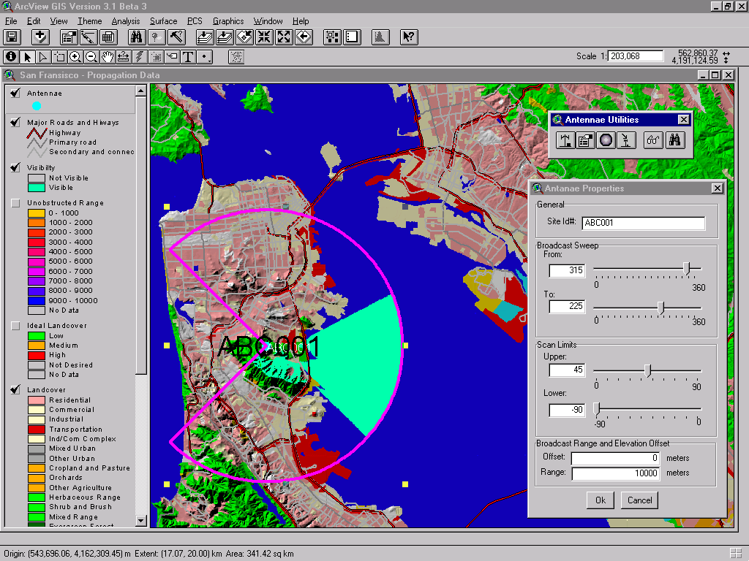
Antenna Propagation Coverages

Slide 42
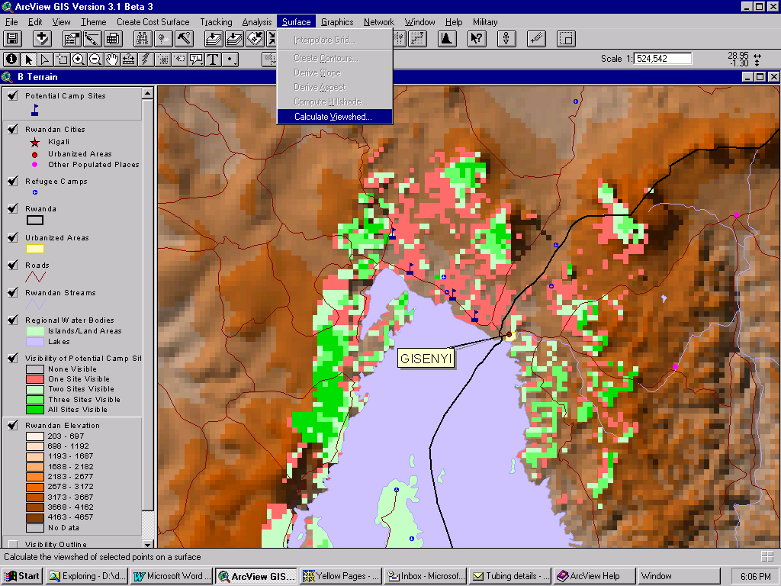
Observation Post Siting Analysis

Slide 43
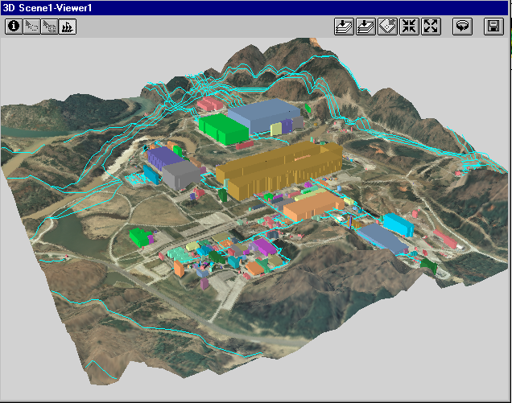
Perspective Views
Notes:
This slide shows a perspective view. A LANDSAT image has been draped over DTED and the buildings have been overlaid over the image and “grown” to represent a 3D view.

